Slide 1
Introduction to Cloud Computing
Cloud Security Day 1

Slide 2

Class Objectives
By the end of today’s class, you will be able to:
Distinguish between cloud services and identify an appropriate service depending on an organization's needs.
Set up a virtual private cloud network.
Protect the cloud network with a firewall.
Deploy a virtual computer to your a network.
2
Notes:
shutterstock_1214853796

Slide 3

Make sure you are signed into your personal Azure accounts, not your cyberxsecurity accounts
3
3

Slide 4

Introducing Cloud Computing
Before the cloud, organizations set up networks on devices they owned and controlled. These setups are called on-premises networks, because they live on machines owned and operated on the company's physical property.
On-Premises
Cloud
Today, the cloud and cloud services dominate the computing industry. Many organizations want to move operations to a cloud provider, but are worried about security.
4
Notes:
AdobeStock_75404501 modified

Slide 5
Complexities of the Cloud
The cloud introduces different security concerns from on-premises setups:
Term | Definition
Complex architecture | Systems must be built to ensure basic security and allow infrastructure personnel to securely monitor, reconfigure, and redeploy machines as needed.
Extensive management | The cloud offers more flexibility than organizations are used to, giving them freedom to create many more machines. This flexibility makes operations management more complex, requiring additional skills and techniques.
Different threats | The cloud is exposed to public networks. Providers handle certain aspects of security, which means security professionals have new and different considerations. Malicious actors will execute new escalation and lateral movement tactics.
Ensuring availability | High availability of machines is a large part of security on the cloud. Ensuring availability and redundancy on the cloud is different than with on-premises environments.
5

Slide 6
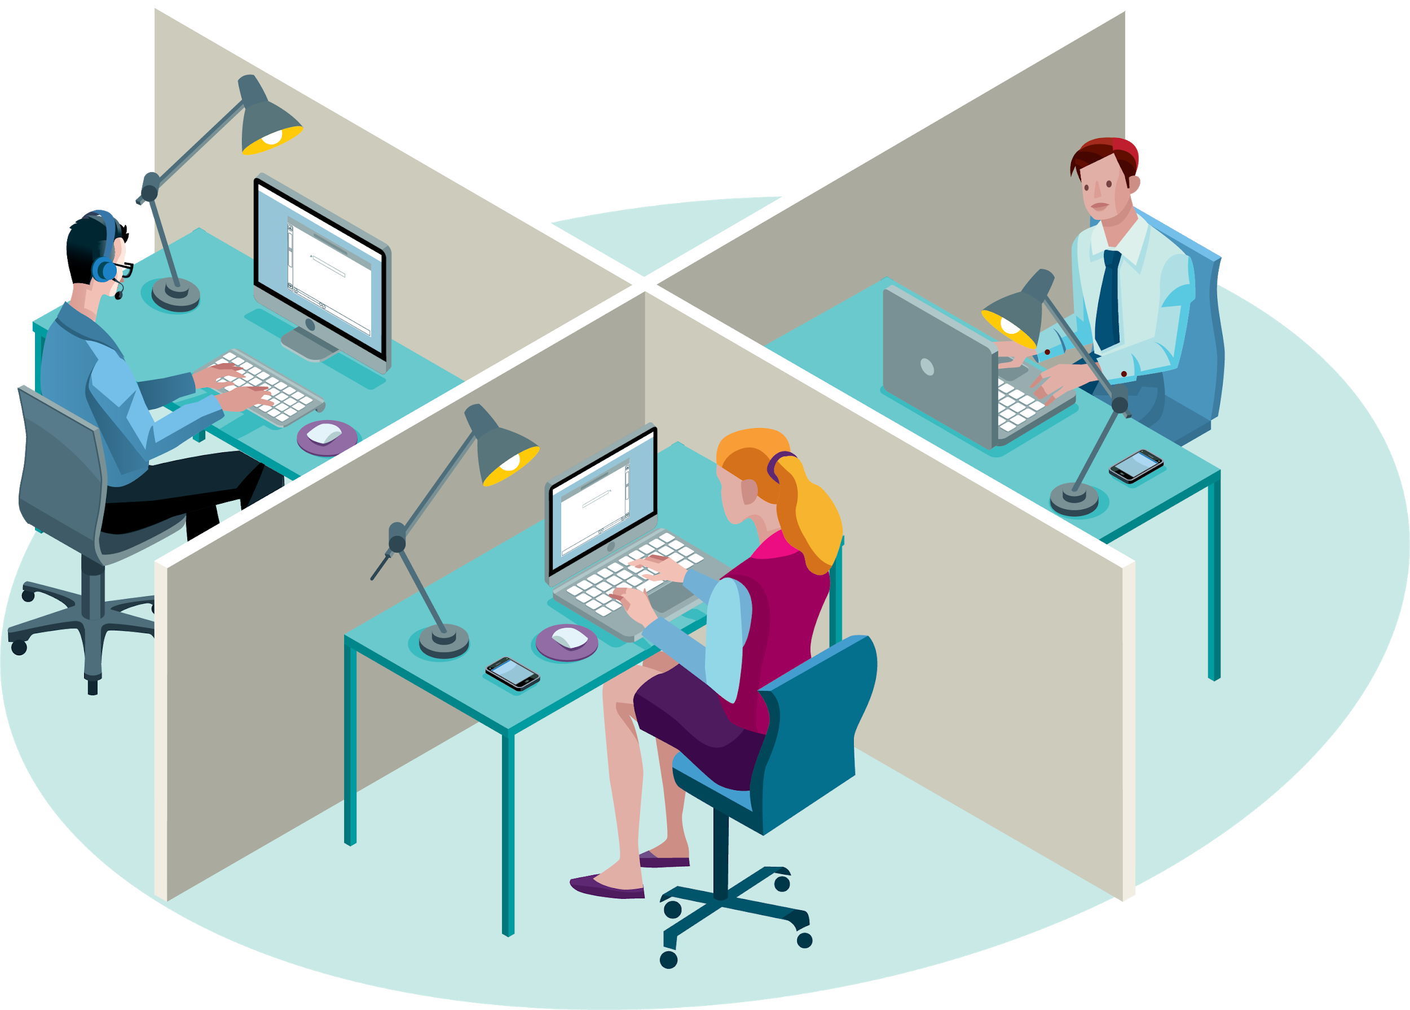
Professional Context
Cloud Security Analyst or Cloud Penetration Tester
These roles must understand cloud architecture in order to test the security settings for a given environment.
DevSecOps
These roles are responsible for maintaining production and testing environments for an organization. They’re expected to build and maintain secure systems at every step of the development process.
Cloud Architect
This role builds out a cloud environment for an organization. They’re expected to understand how to build in security from the ground up.
6
Notes:
Shutterstock_230888839 modified

Slide 7
Cloud Service Model
7

Slide 8

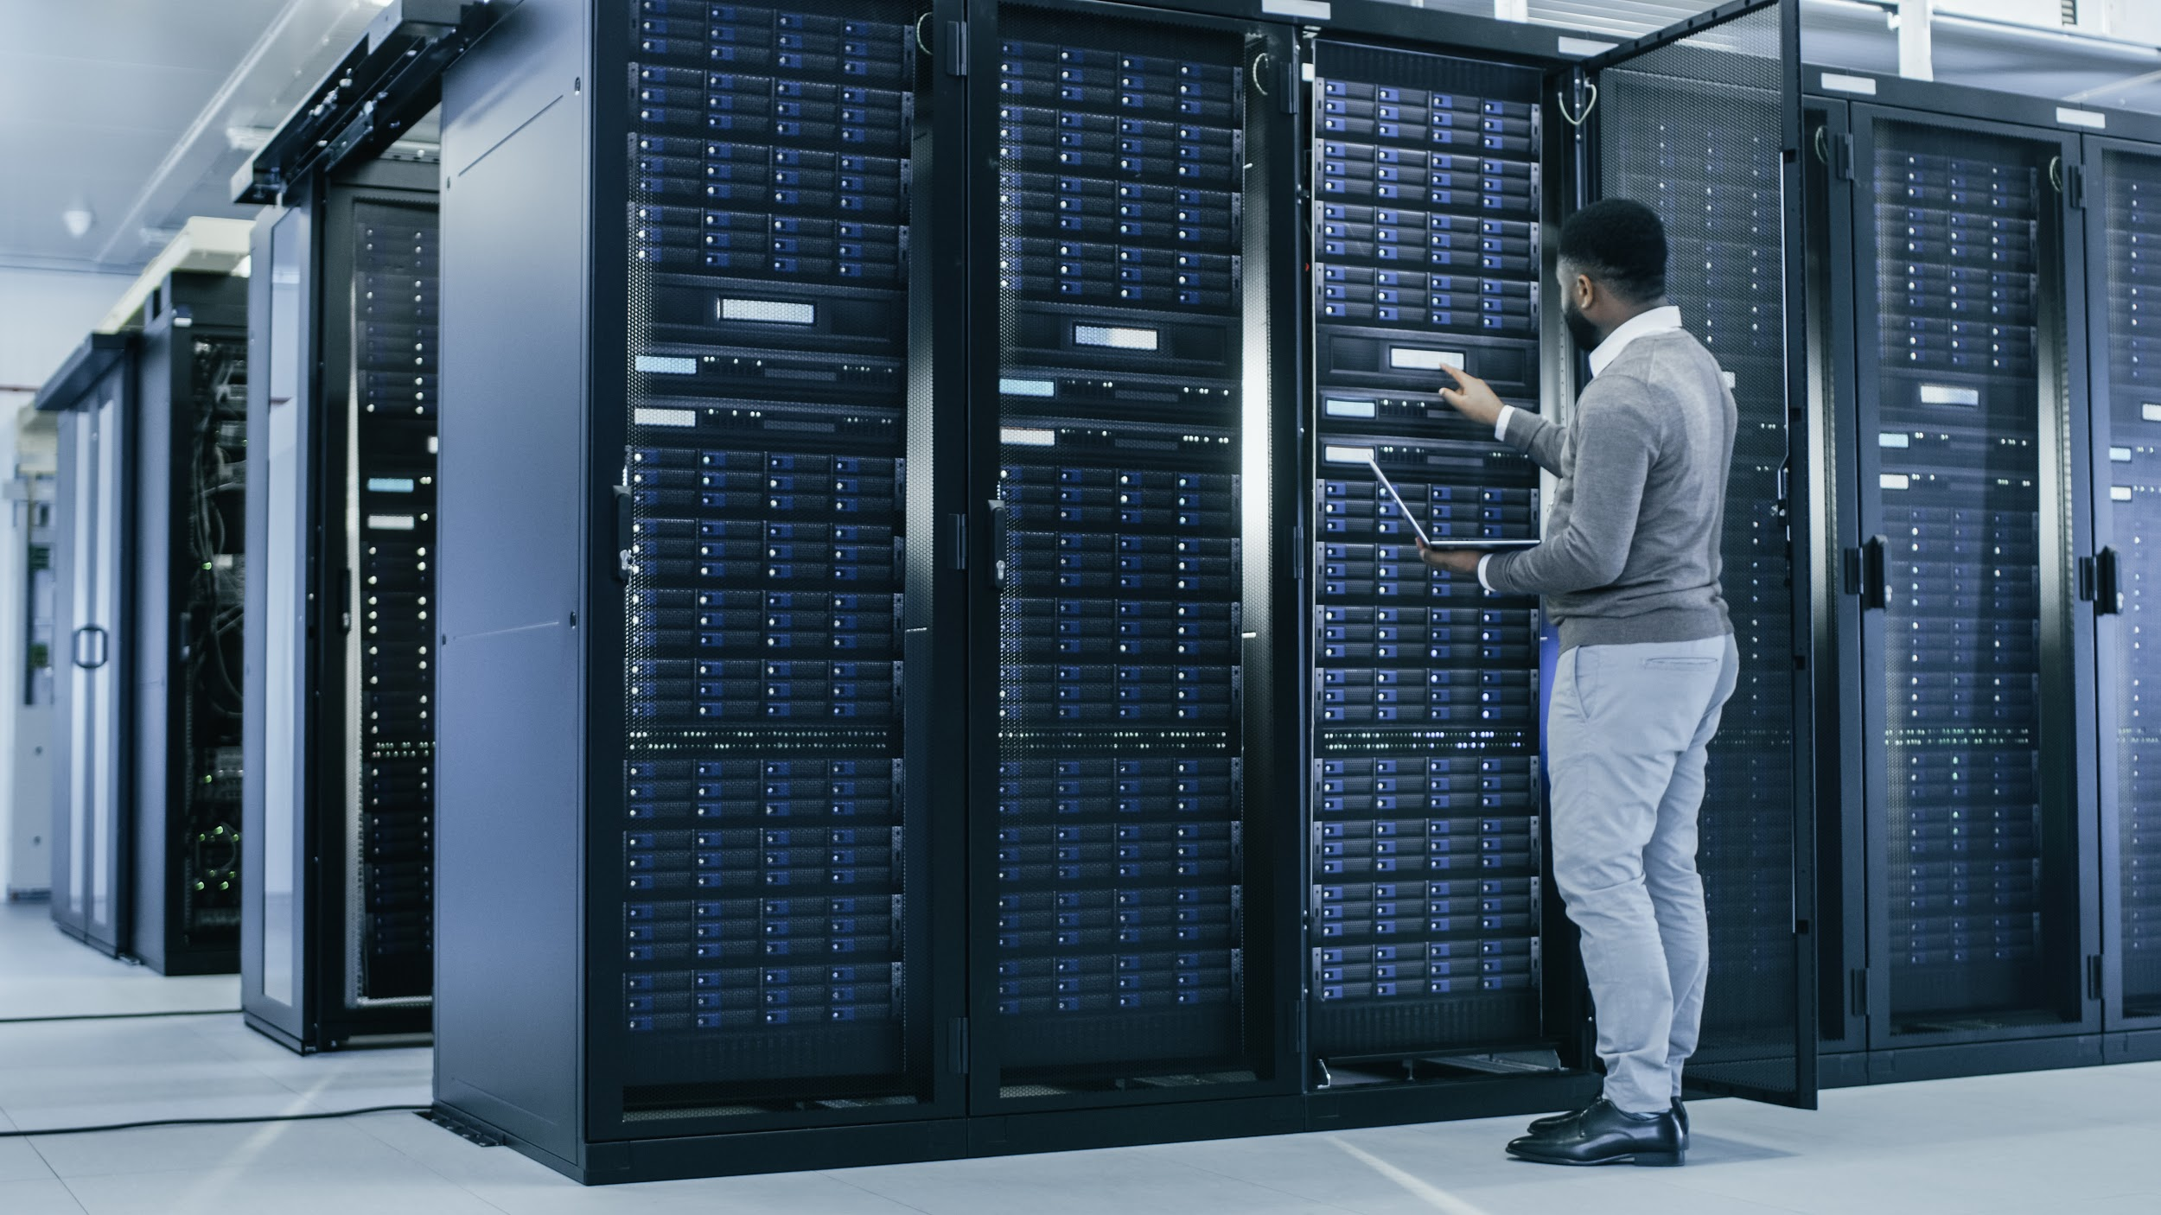
Think of the cloud in the same way you would think of an on-site data center or network.
The cloud has all of the same equipment: servers, virtual machines, routers, firewalls, load balancers, etc.
The difference is that, in the cloud, most of these items are virtualized, meaning they are software.
8
Notes:
shutterstock_376862737

Slide 9
Cloud Service Model
The fact that cloud networks are virtualized and defined by software gives them numerous security benefits:
01
Ground up security
02
Easy configuration
03
Quick turnaround
04
Personalized provisions from cloud providers
05
High availability and fault tolerance
06
Easy implementation
07
Affordability
9

Slide 10
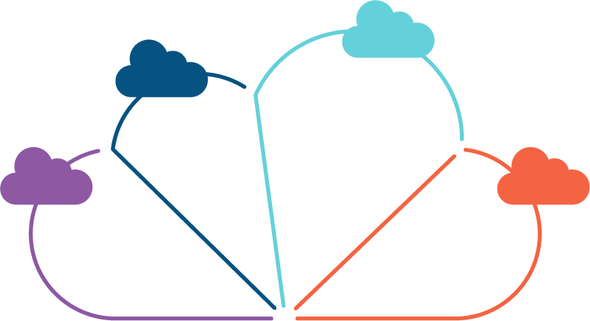
Models of Cloud Services
SaaS
PaaS
Software as a
Service
Platform as a
Service
IaaS
DaaS/ DBaaS
Infrastructure as a Service
Data as a Service/ Database as a Service
10
Notes:
AdobeStock_121435682_modified

Slide 11

IaaS (Infrastructure as a Service)
A service provider offers pay-as-you-go access to storage, networking, servers, and other computing resources in the cloud.
11

Slide 12
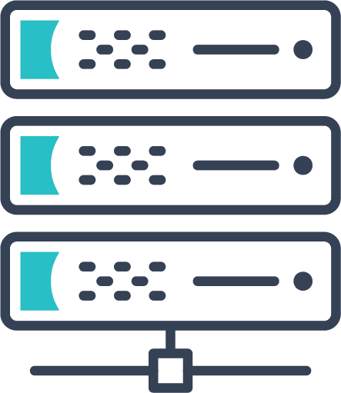
IaaS (Infrastructure as a Service)
Security benefits include:
01
High availability.
02
Assurance that base machines are up-to-date at the time of deployment.
03
Provider-enforced security controls, such as basic access management.
Organizations can focus on implementing functionality and security relevant only to their business concerns, and not worry about the basics of secure deployments.
12
Notes:
shutterstock_433461364

Slide 13


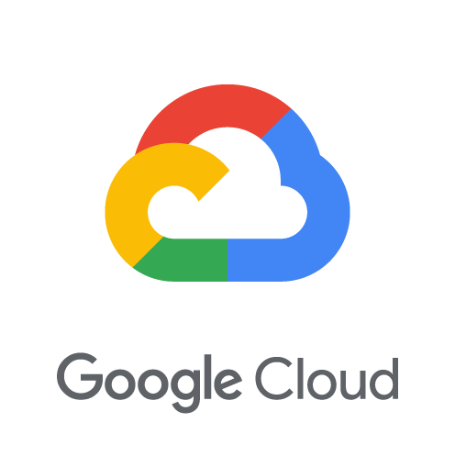
all offer IaaS
13

Slide 14
PaaS (Platform as a Service)
A service provider offers access to a cloud-based environment in which users can build and deliver applications. The provider supplies the underlying infrastructure.
14

Slide 15
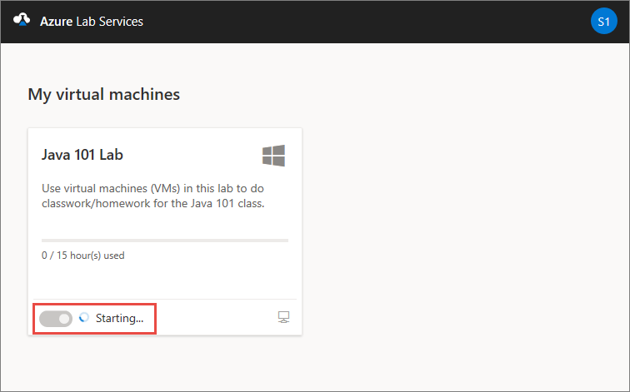

PaaS (Platform as a Service)
Organizations can leverage powerful applications that are guaranteed to be secure and available, without having to implement security themselves.
Azure Classroom Labs, on top of which this course’s lab environments are deployed, is one example.
It includes guarantees availability by design and locks down access to only those ports necessary to connect to the labs.
(Microsoft Azure)
15
Notes:
shutterstock_433461364

Slide 16
SaaS (Software as a Service)
A service provider delivers software and applications through the internet. Users subscribe to the software and access it through the web or vendor APIs.
16

Slide 17
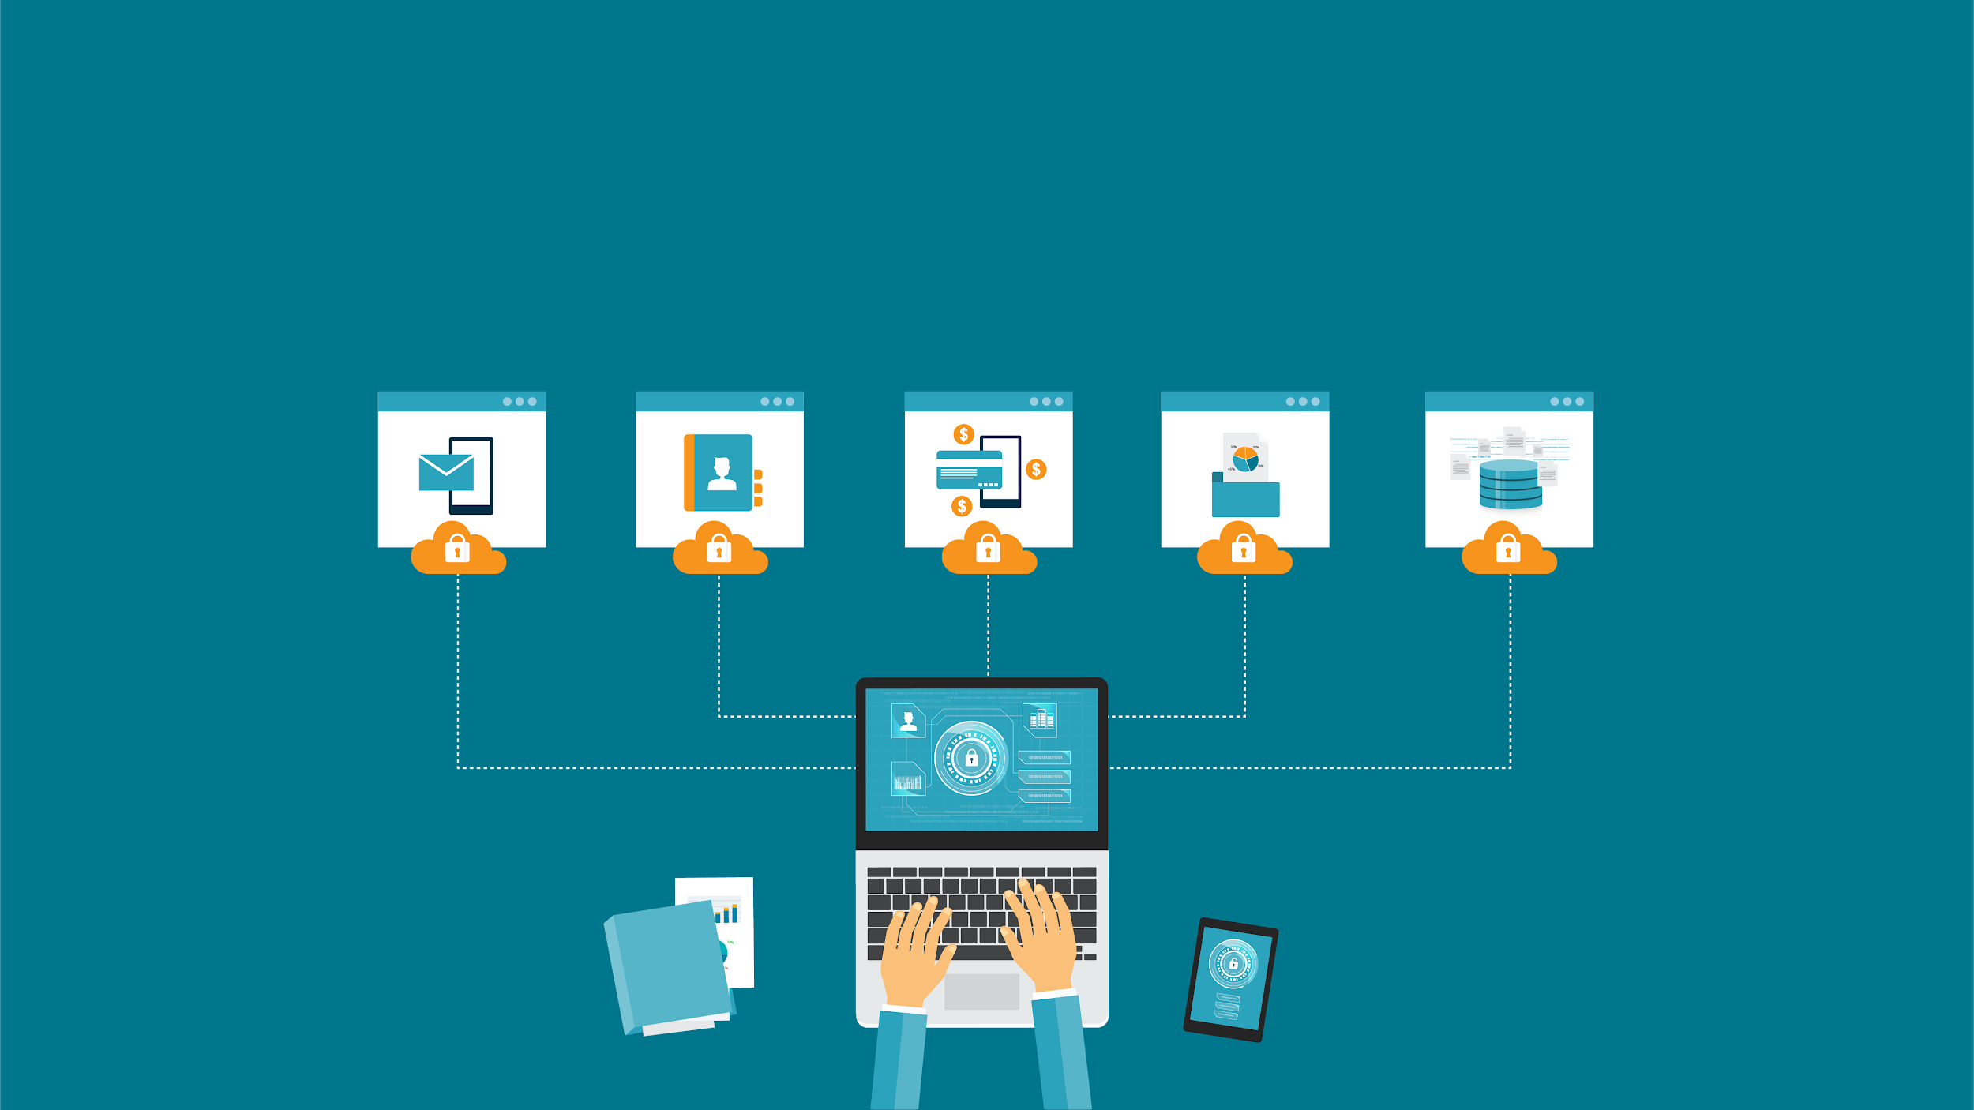
SaaS (Software as a Service)
The software runs in environments that are guaranteed by the provider to be secure. Engineers do not need to worry about secure deployment.
17
Notes:
AdobeStock_152285066

Slide 18
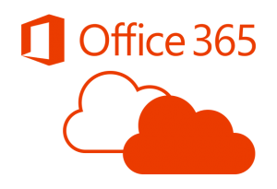
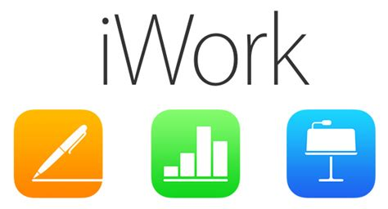
Cloud software such as the Microsoft 365 Cloud Office Suite and Apple’s Cloud iWork are examples of SaaS.
18

Slide 19
DaaS/DBaaS (Data as a Service/ Database as a Service)
A service that provides a company's data product to the user on demand, regardless of geographic or organizational distance between provider and consumer.
19

Slide 20

DaaS/DBaaS (Data as a Service/Database as a Service)
The main security advantages of DaaS are high-availability and fault tolerance.
DaaS ensures data is always available, even if there is a power outage at a single data center, and ensures that data is deployed as close as possible to those consuming it, reducing latency.
20
Notes:
shutterstock_1165288549

Slide 21
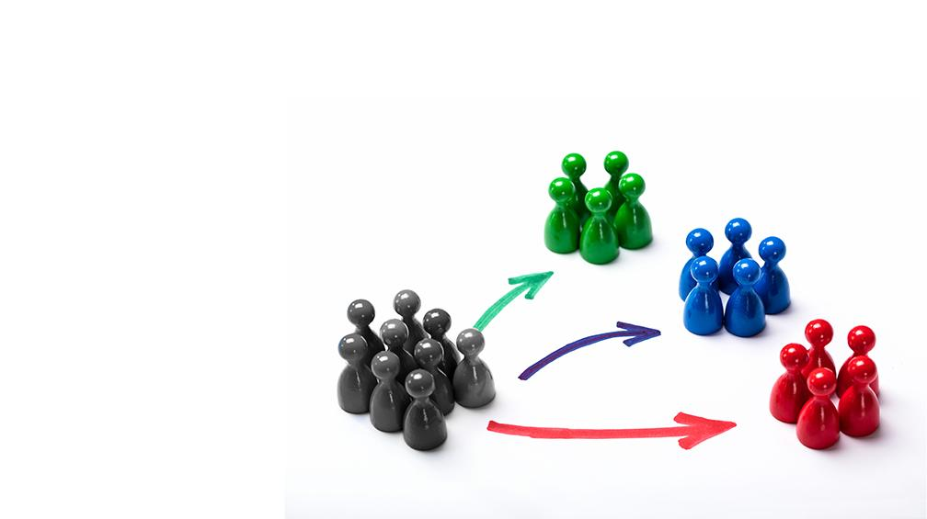
DaaS/DBaaS (Data as a Service/Database as a Service)
An example of a DaaS is a marketing company that keep databases of consumers categorized for many different industries.
21
Notes:
AdobeStock_190671366

Slide 22
CaaS (Communications as a Service)
A service that provides an outsourced communications solution. Such communications can include Voice over IP (VoIP or Internet telephony), instant messaging (IM), and collaboration and video conference applications.
22

Slide 23
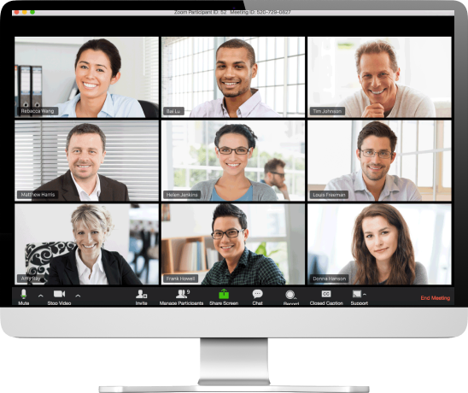
CaaS (Communications as a Service)
CaaS guarantees security by ensuring that communications are not vulnerable to eavesdropping, and provides comprehensive monitoring/record-keeping for auditing purposes.
(Zoom.us)
23

Slide 24




are all examples of CaaS
24

Slide 25
XaaS (Anything as a Service)
Services providing all the offerings via cloud computing as opposed to locally, or on-premises.
25

Slide 26
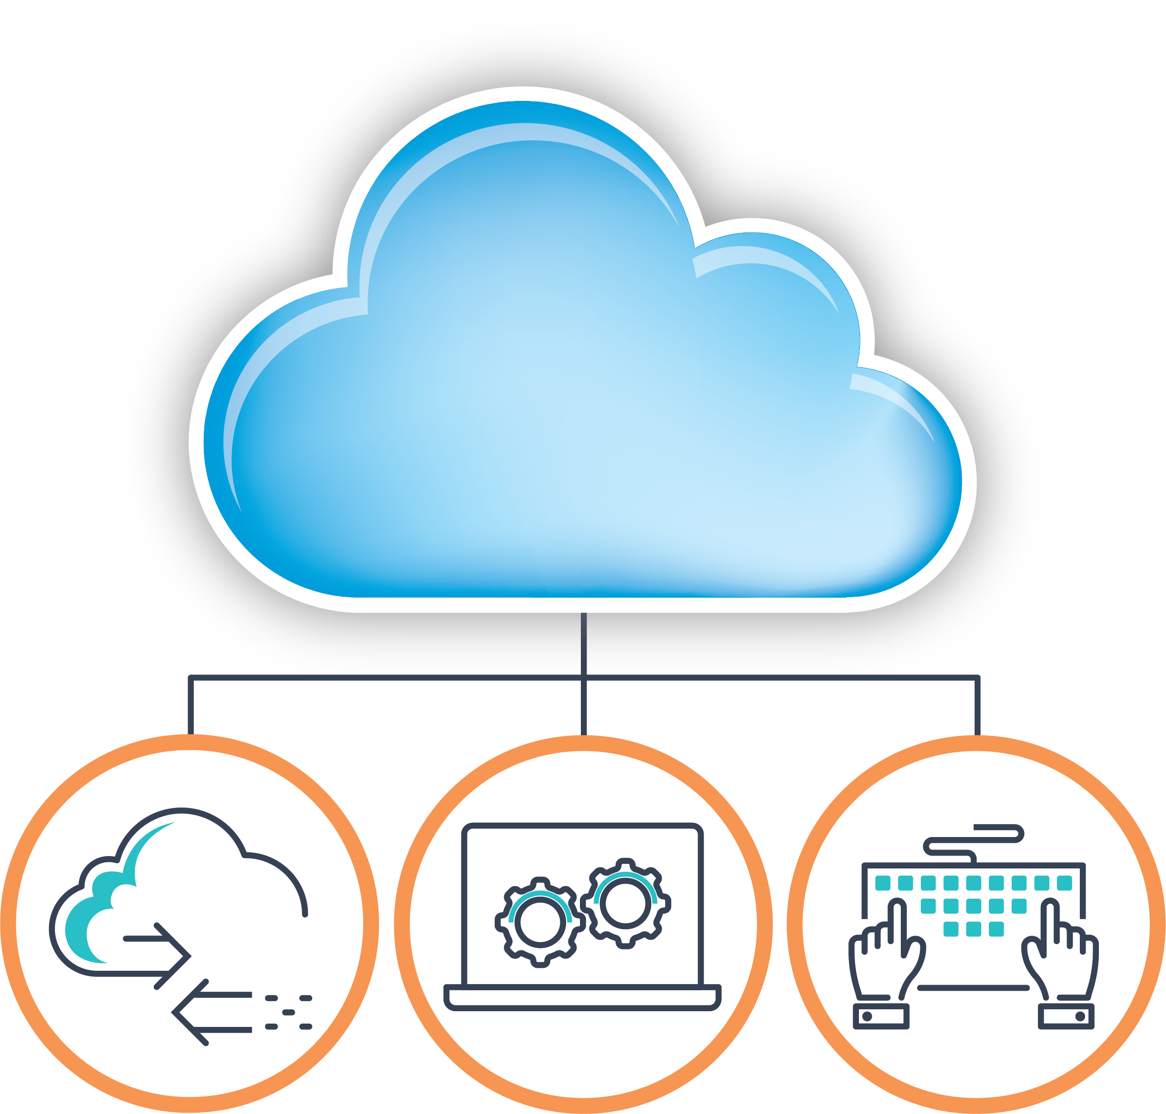
XaaS (Anything as a Service)
XaaS
Communications
Data
Software
26
Notes:
Cloud Shutterstock_113185543 Icons shutterstock_433461364

Slide 27
In class today, we will begin creating a cloud infrastructure environment that will be used for the rest of this unit, as well as for later units.
27
27

Slide 28


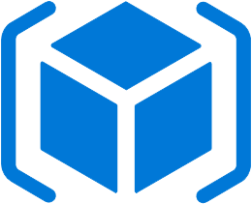
Staying Organized: Resource Groups
In Azure, resource groups allow engineers to sort related resources into different groups, each of which can be easily located by name.
Subscription
A resource group:
Is a logical grouping of all resources used for a particular setup or project.
Will contain the network, firewalls, virtual computers, and other resources needed
for setup.
Resource Groups
28

Slide 29
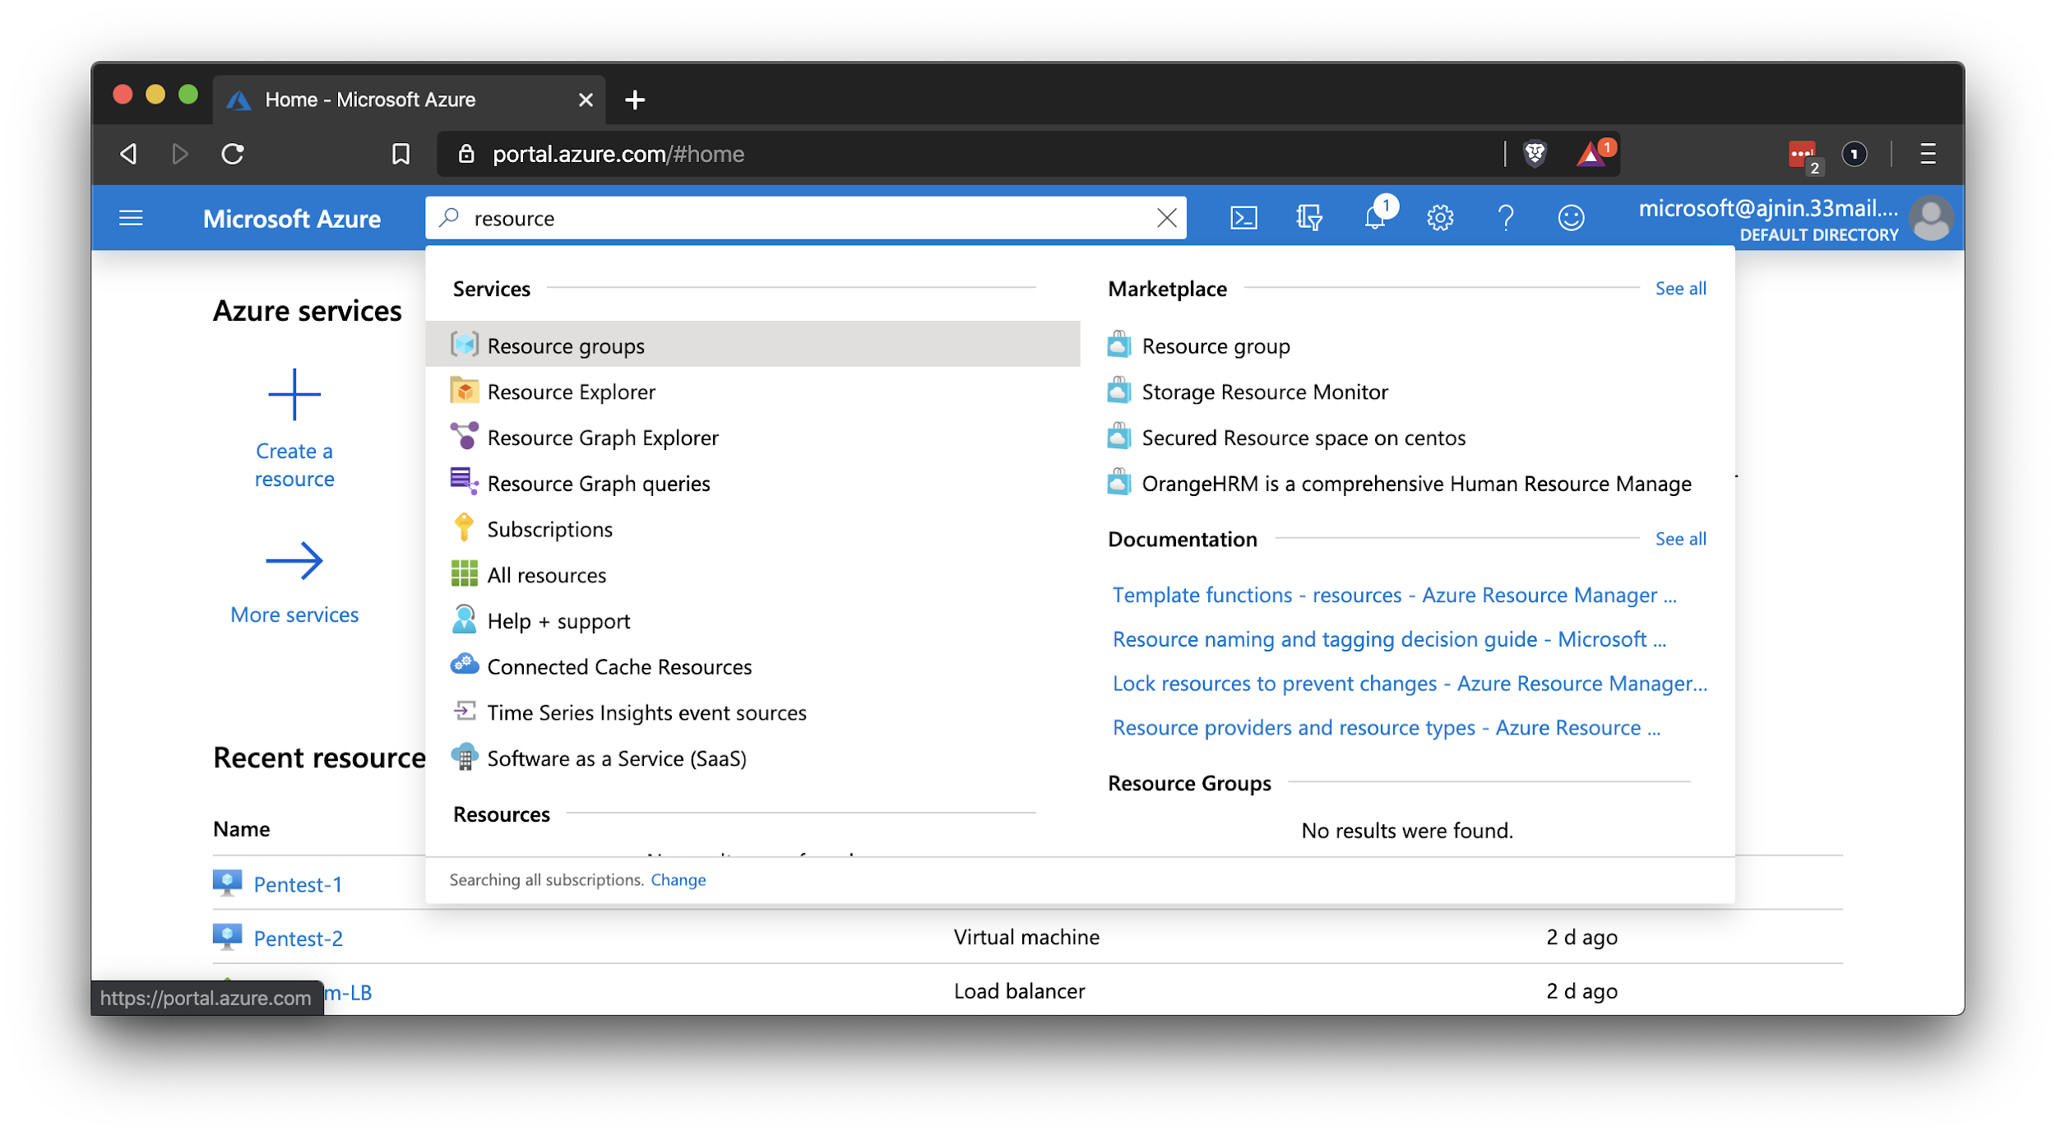
Creating Resource Groups
The first step to creating an environment in Azure is to create a resource group. We can then start adding other items, the first of which will be a virtual network.
portal.azure.com/#home
29

Slide 30
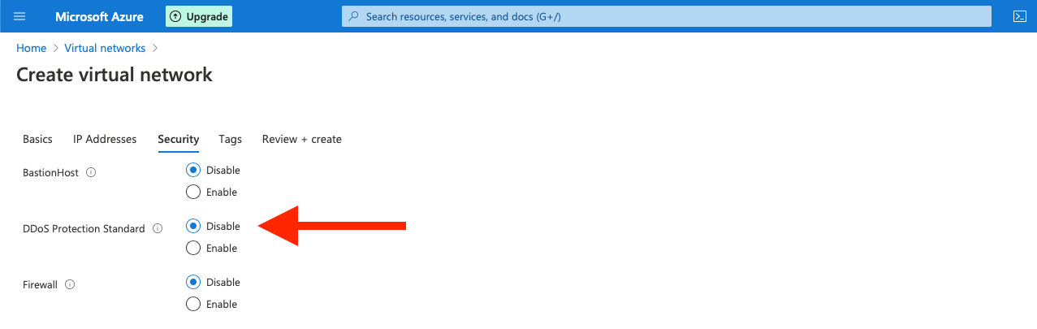
Creating Resource Groups
As we set up our virtual network, avoid recurring charges by making sure DDoS Protection Standard is not enabled.
In a real application, all we need to do is make sure it is enabled in order to configure DDoS protection. When enabled, Azure provides near real-time monitoring for DDoS traffic. In class, we want to avoid using this feature so that we do not incur additional charges.
portal.azure.com/#home
30

Slide 31
Setting Up Resource Groups
31

Slide 32
Now that we have a resource group, we can add a virtual network, a collection of virtual machines that can communicate with one another.
32
32

Slide 33
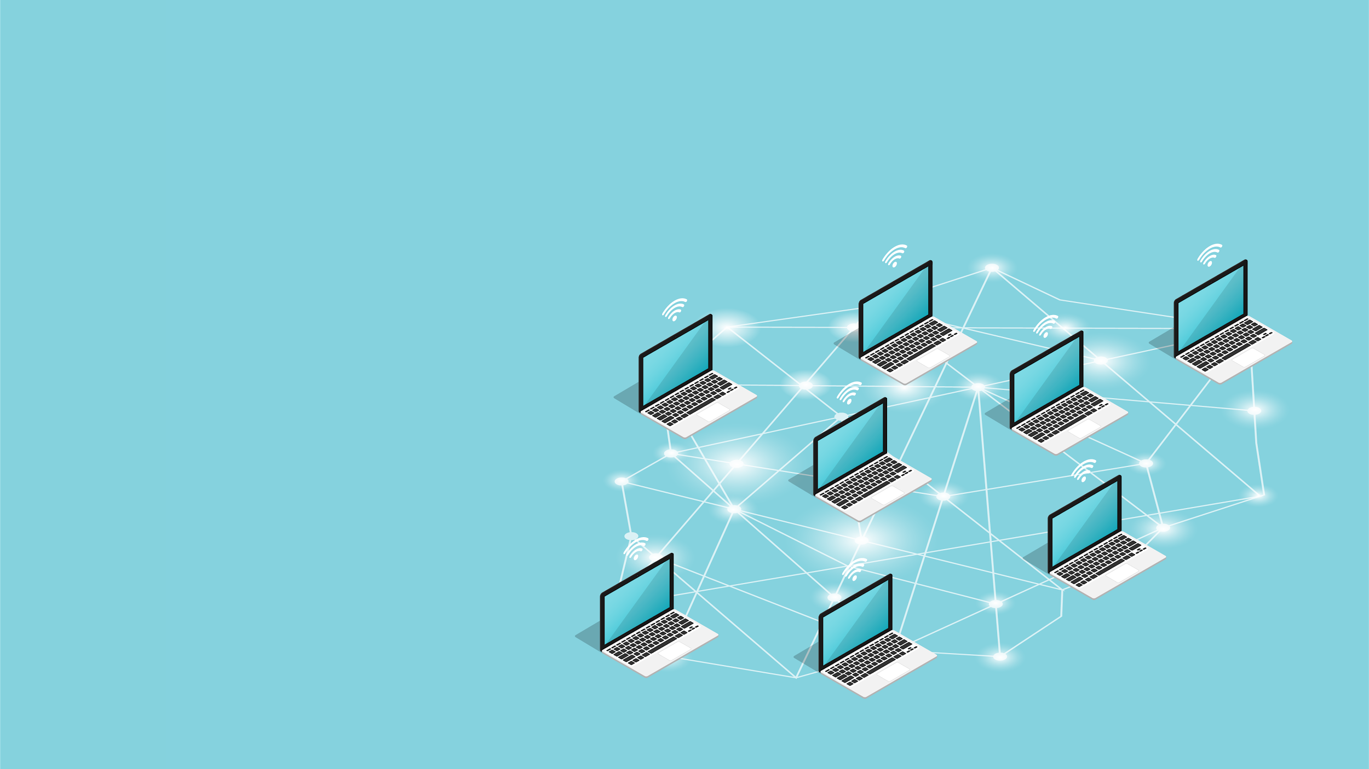
Adding Virtual Networks
Unlike physical networks, where connections and discovery depend on physical wiring, virtual networks are much more flexible.
VMs on a virtual network can live in different data centers but perform as if they are wired, and provide improved availability.
Virtual networks can be quickly and easily reconfigured by clicking a few buttons in the portal.
This is dramatically faster and safer than rewiring a physical network to implement improved segmentation. It also results in less human error.
33
Notes:
AdobeStock_170811105

Slide 34
Adding Virtual Networks
In order for virtual networks to behave identically to physical ones, cloud providers use software to emulate everything a physical machine uses to interact with the network.
01
02
03
vNICs (Virtual Network Interface Cards)
Similar to physical machines, VMs have software versions of "normal" NICs.
Just like physical machines, VMs can have multiple vNICs.
IP Addresses
VMs have IP addresses just like physical computers.
IP addresses are considered their own type of resource in Azure, AWS, and other cloud environments.
Subnets
Like IP addresses, subnets are considered separate resources, meaning they can be created independently of the others.
After creating a virtual network, we can create a new subnet and add it to the existing network. We can also create a new public IP address resource and associate it with an existing virtual machine.
34

Slide 35
Quick Review: IP Address Structures
Let’s review the IP structures learned earlier in the course.
Private networks will use one of three IP schemes:
192.168.x.x
172.16.x.x
10.x.x.x
We can also use CIDR notation when defining a network space:
192.168.1.0/24
When creating a network in Azure, we will define a large network as well as a subnet inside that network:
10.0.0.0/16
for the large network.
10.10.1.0/24
for the first subnet.
35

Slide 36
Activity: Virtual Networking
In this activity, you will create a resource group and virtual network for a Red Team training environment.
Important: For this and all activities, make sure that you are using your personal Azure account.
20 Minutes
36

Slide 37
37

Slide 38
38

Slide 39
Security Groups
39

Slide 40
Now that we have a virtual network set up, we will protect it with a firewall.
40
40

Slide 41



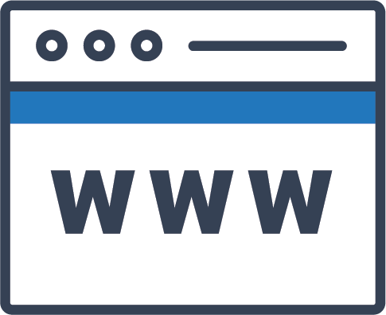

Security Groups
On the Azure platform, our basic firewall is called a network security group (NSG).
We will use a network security group to block and allow traffic to our virtual network and between machines on that network.
Microsoft Azure
Virtual Machine
Virtual Machine
Virtual Network
Network Security Group (NSG)
Inbound Rule
41
Notes:
Person: AdobeStock_67450164 Monitor: AdobeStock_24348416

Slide 42


Security Groups Demonstration
Many resources can be created independently of any particular virtual network and then attached to a VNet after creation. Network security groups are a perfect example of this concept.
In the next demonstration and activity, we will create an NSG that blocks all traffic to and from the network, and then attach it to the VNet.
42
Notes:
shutterstock_204345808

Slide 43
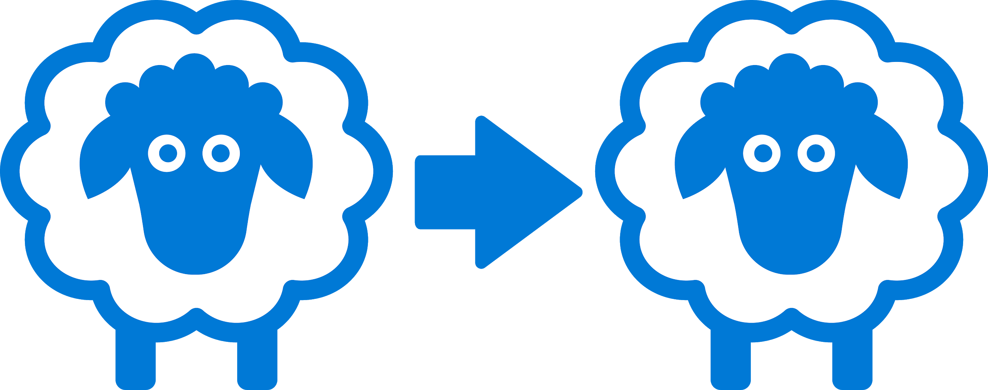
Security Groups Demonstration
This model has the advantage of allowing security engineers to create NSGs for different traffic profiles, which they can then replicate and apply to any VNet.
For example, we can create an NSG called Desktop Connections, which clears RDP and VNC traffic to and from the VNet.
Engineers can then use this NSG as a template, clone it, and apply it to any new or existing VNet that requires this type of access.
43
Notes:
shutterstock_1425764027

Slide 44
Setting Up Security Groups
44

Slide 45
Activity: Security Groups
In this activity, you will create a network security group to control access to any resources in the subnet you created in the last activity.
Important: For this and all activities, make sure that you are using your personal Azure account.
20 Minutes
45

Slide 46
Virtual Computing
46

Slide 47
When we set up a virtual machine, we have to decide how powerful we need the machine to be by choosing each of the main “hardware” components.
47
47

Slide 48
Hardware Components
Term | Definition
RAM (Random Access Memory) | The amount of memory dedicated to running computer operations. The computer uses RAM to temporarily store data that it needs to access to quickly.
Storage (HDD / SSD) | The part of the computer that stores data permanently. This is data that you do not expect to lose when the computer is turned off.
Disks | Disks attached to a VM fall into two general categories: OS disks contains the operating system, kernel, and everything required for the VM to function. Data disks contain data that the VM doesn't need in order to run, but which users need to do their jobs.
CPU (Central Processing Unit) | CPU is like the brain of the computer. It's the part that actually computes all the 1s and 0s. The CPU takes code and data out of the long term storage, loads it into RAM, and performs the computations specified by an application.
48

Slide 49
A virtual computer has software versions of these components.
When we create a virtual computer, we define the “hardware,” such as the amount of RAM, the storage space, and the CPU.
Once it’s defined, we can install an operating system and use it as if it’s a normal computer.
49
49

Slide 50


Availability vs. Cost Tradeoff
While it is possible to simply choose the “best” option available, it’s not advisable. The cloud provides great flexibility for users, but this flexibility can come at a cost.
Before working with devices on the cloud, we must always set budget limits and cost-control policies. Otherwise, we can accidentally exceed our employer's budgets.
50
Notes:
shutterstock_731039515

Slide 51
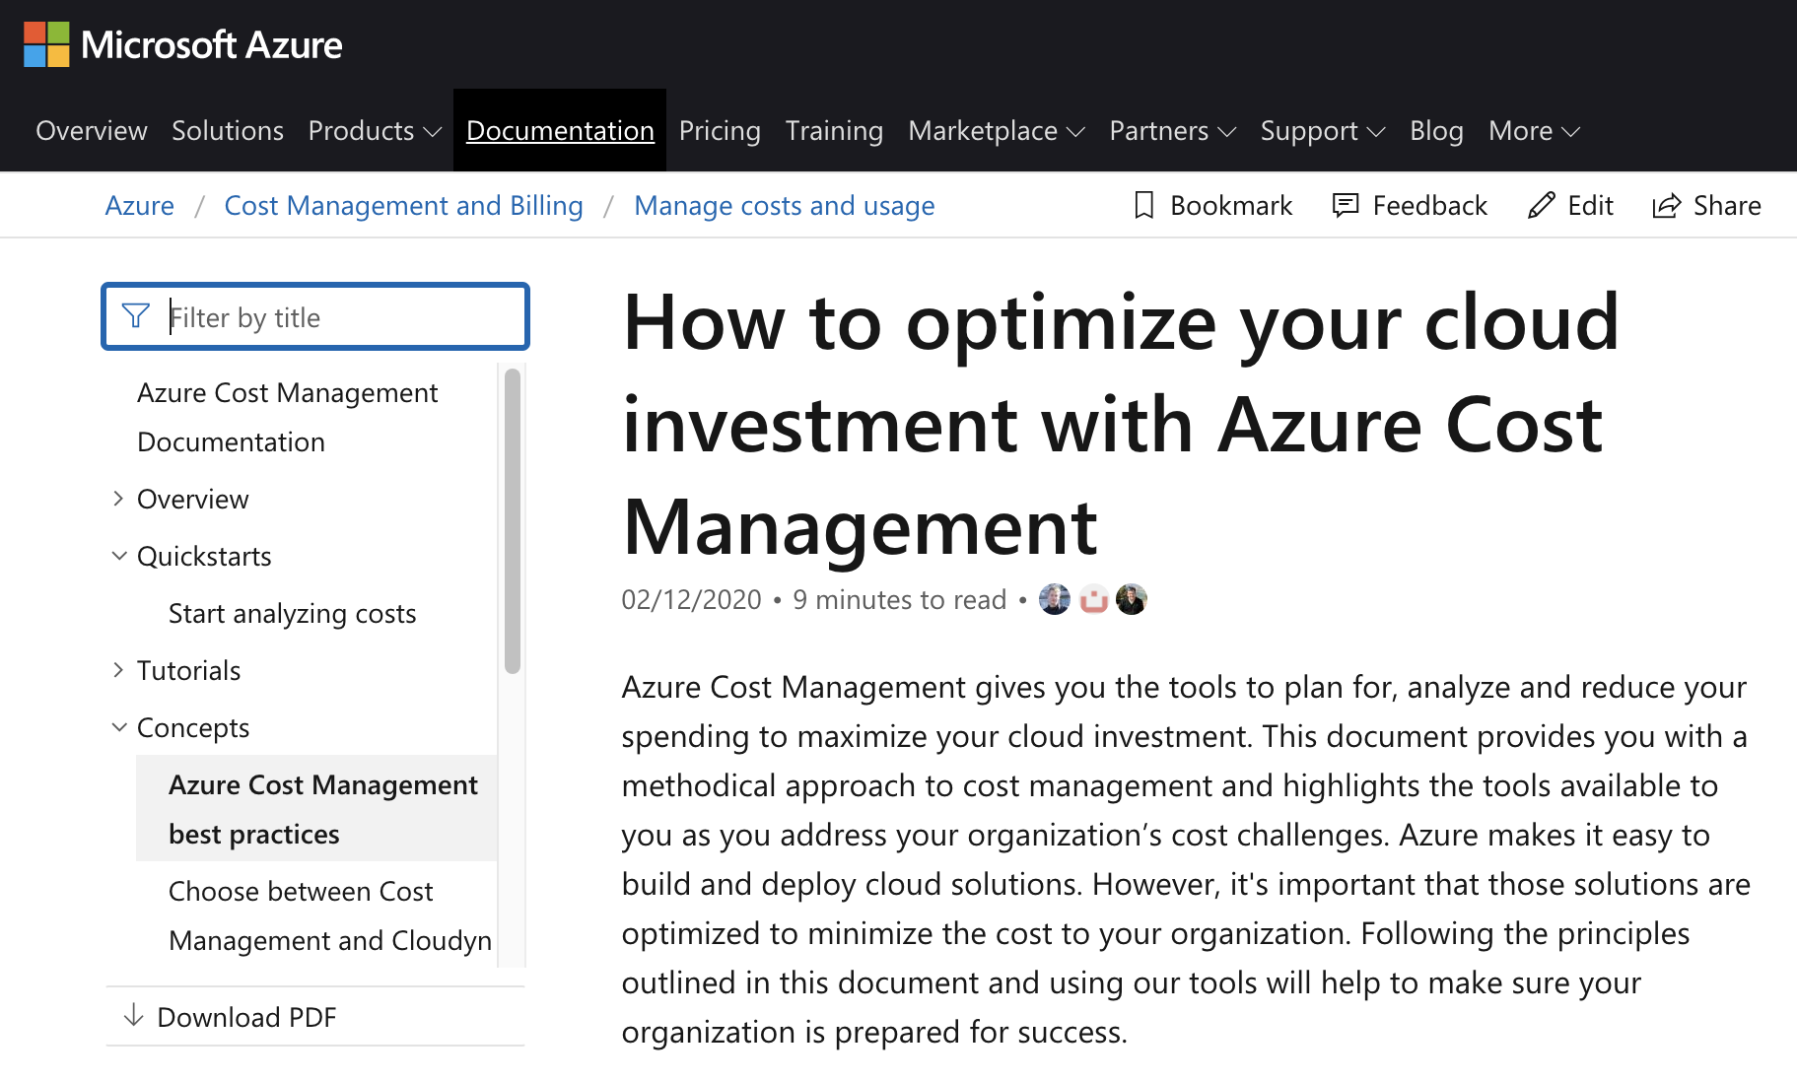
Availability vs. Cost Tradeoff
Azure provides cost-control tools as a free service, which you should study prior to managing live cloud deployments.
(Microsoft.com)
51

Slide 52
Getting Ready to Create a VM
52

Slide 53
Activity: Virtual Computing
In this activity, you will tasked with setting
up a new Ubuntu VM inside the Red Team resource group, to be used as a jump box.
20 Minutes
53

Slide 54
54

Slide 55
Daily Checklist
By the end of today, you should have completed the following critical tasks:
Created a total of three VM. One jump-box and two Web VMs
Configured all three VMs with the same SSH key.
The SSH key being used does not have a password associated with the key.
Web VMs are created using the same availability set.
Web VMs should have 2 GB of RAM.
Jump-Box VM only needs 1 GB.
All three VMs should have 1 vCPU.
All VMs are using the same security group and vNet.

Slide 56

Don’t forget to power off your machine!

